Slide 1

SNP Discovery with Stacks
Oregon State University
Center for Genome Research and Biocomputing
May 19, 2015

Slide 2
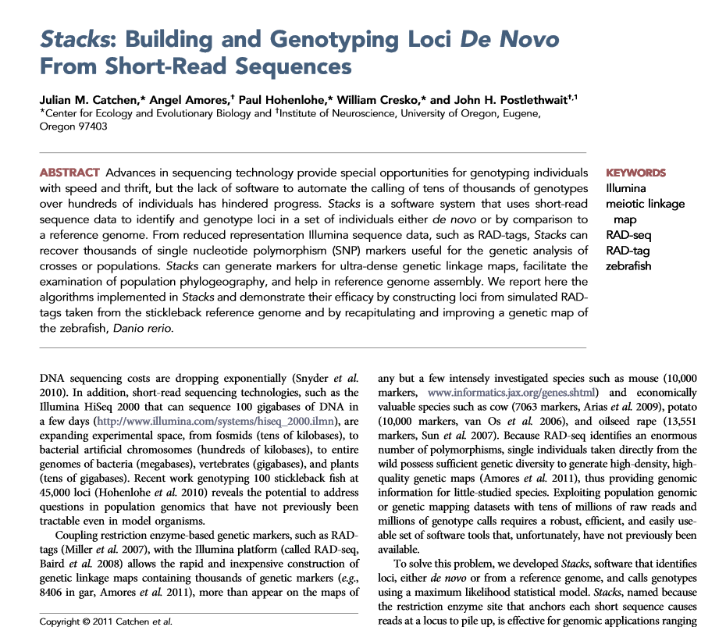
Stacks overview
Developed at University of Oregon
Originally for RAD-seq
Both reference genome-based, non-reference-based pipelines
Outputs file formats used by population genetics, linkage mapping software
For visualization, optional web-based interface (PHP) that interacts with MySQL database server
Excellent online documentation and tutorials!

Slide 3
Stacks resources
Manual page http://creskolab.uoregon.edu/stacks/manual/
Download page http://creskolab.uoregon.edu/stacks/
Google group https://groups.google.com/forum/#!forum/stacks-users

Slide 4
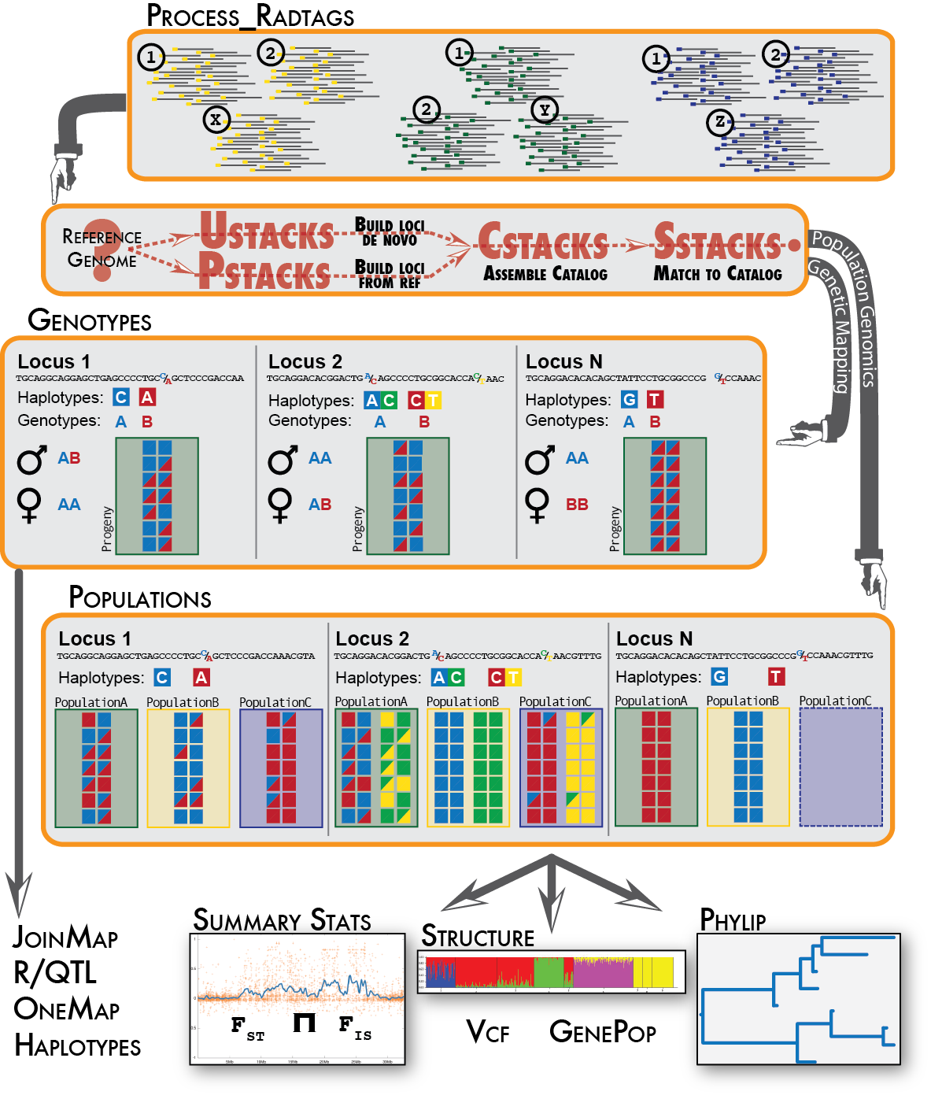
The pipeline
1) Sequence reads demultiplexed, “cleaned”
2) Loci (“stacks”) built from overlapping tags
3) SNP catalog created for population
4) Individuals compared to catalog
5) Genotypes or summary statistics generated

Slide 5
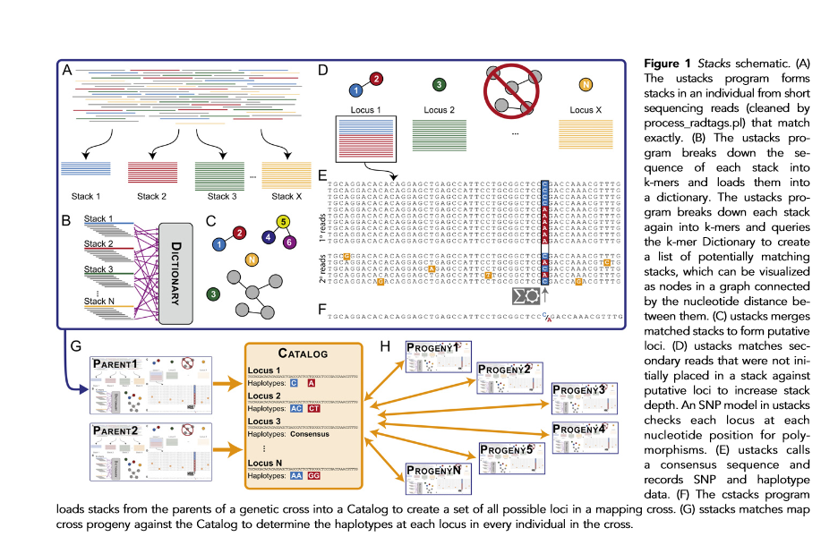
Catchen JM, Amores A, Hohenlohe P, Cresko W, Postlethwait JH. 2011. Stacks: Building and Genotyping Loci De Novo From Short-Read Sequences. G3: Genes|Genomes|Genetics 1: 171–182.

Slide 6
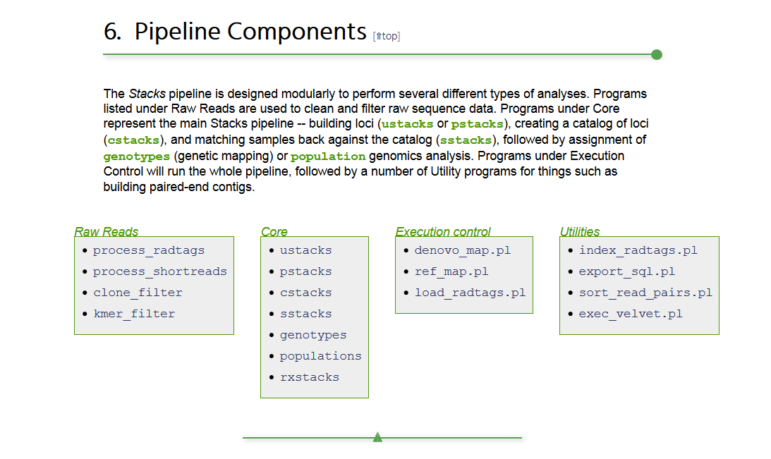

Slide 7
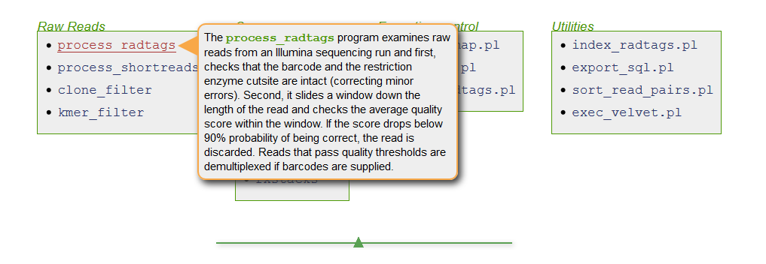
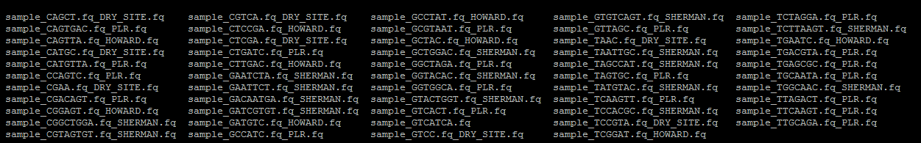

Slide 8
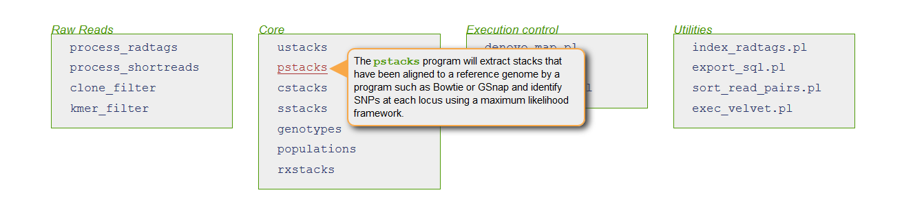
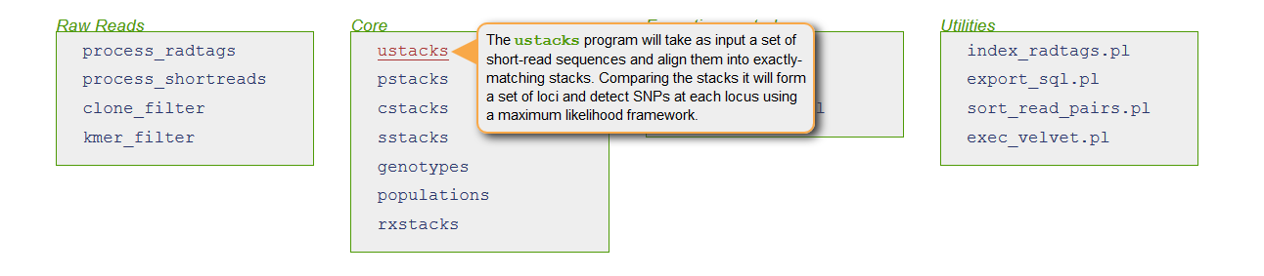
Reference genome?
YES
NO

Slide 9
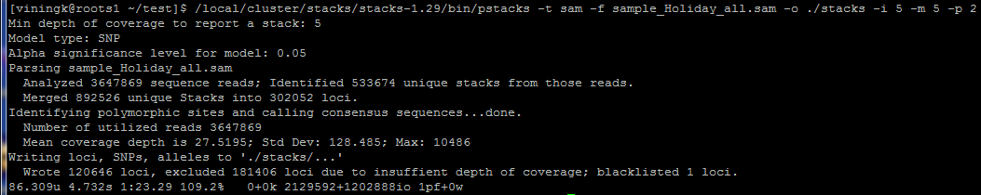
Running pstacks

Slide 10
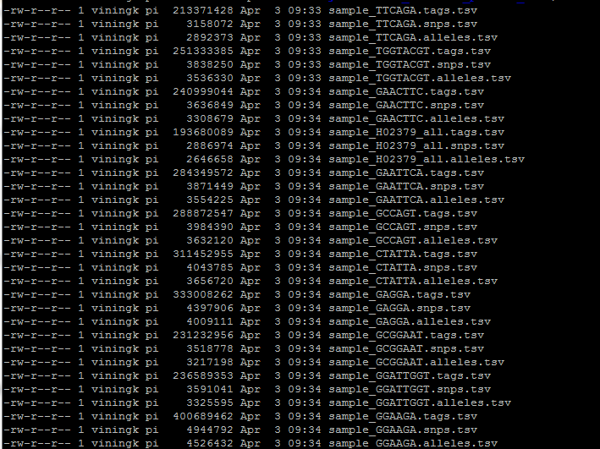
Pstacks, ustacks output
*.tags.tsv
*.snps.tsv
*.alleles.tsv

Slide 11
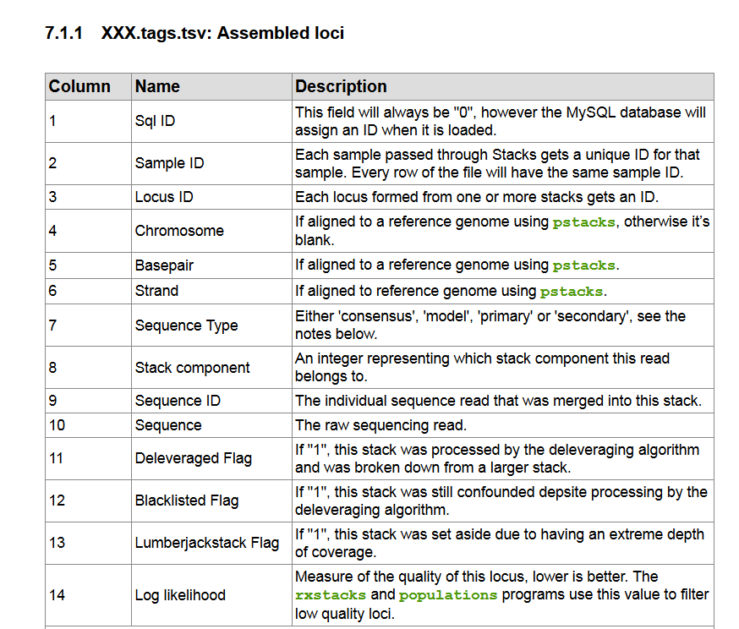

Slide 12
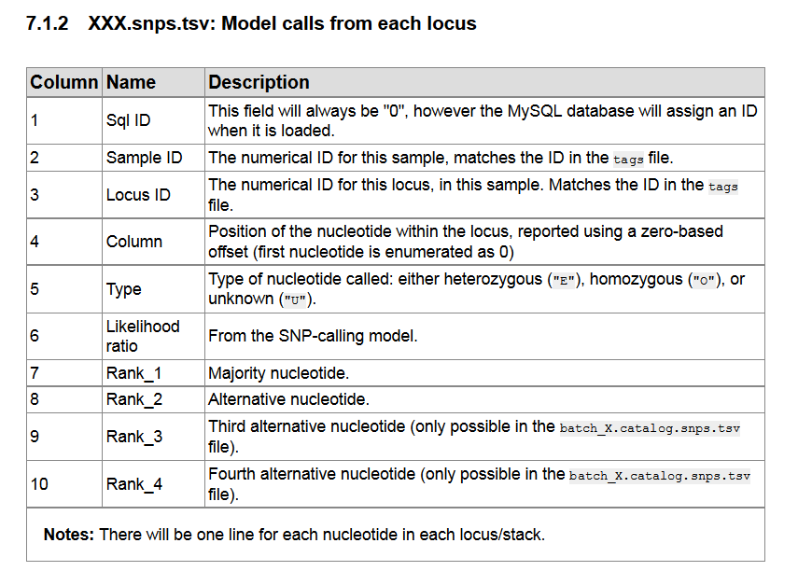

Slide 13
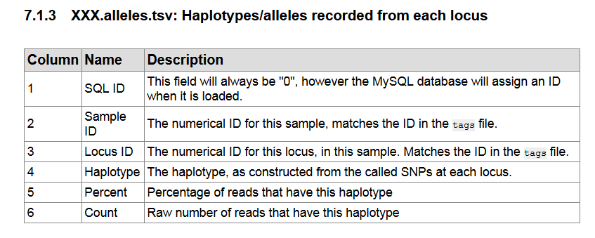

Slide 14
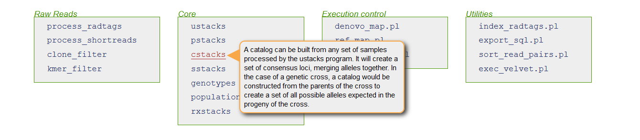
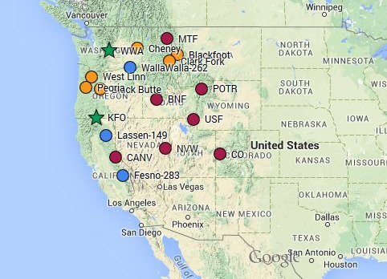
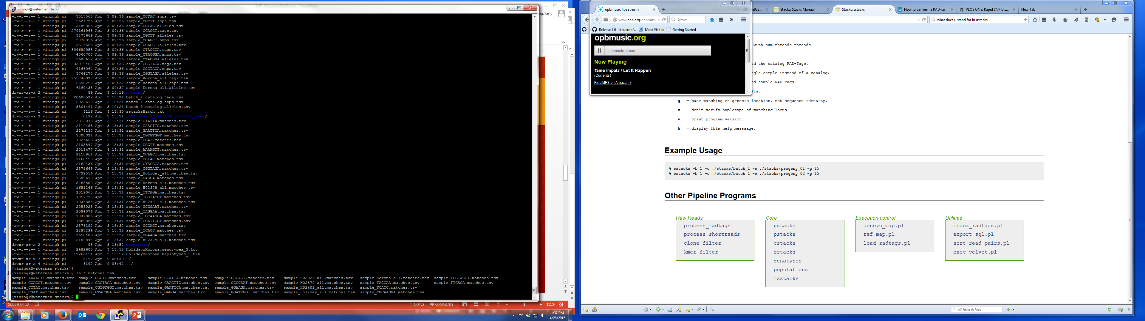
Cstacks builds SNP catalog
Parents
F1
F2
9 : 3 : 3 : 1

Slide 15
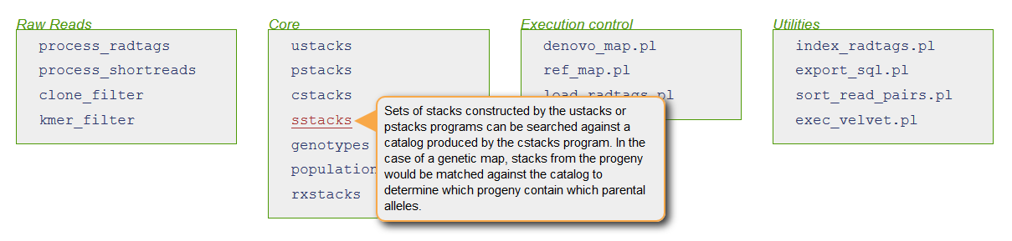
Sstacks matches individuals, catalog

Slide 16
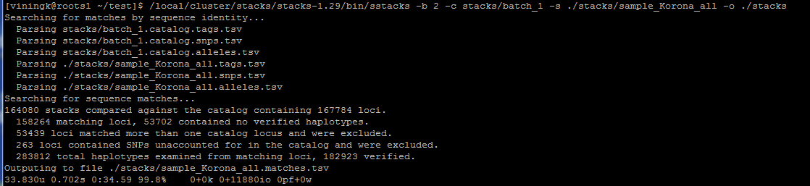
Running sstacks

Slide 17
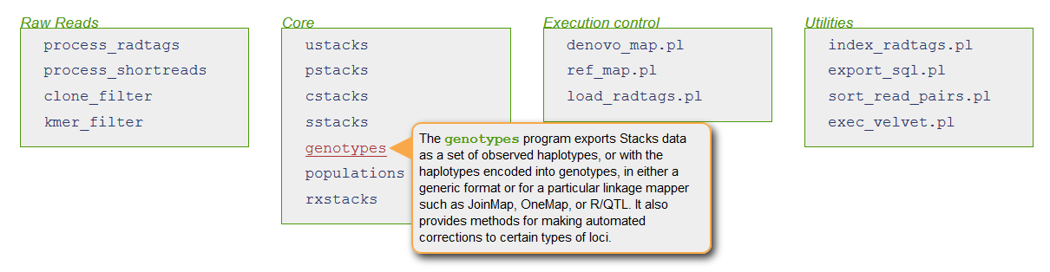
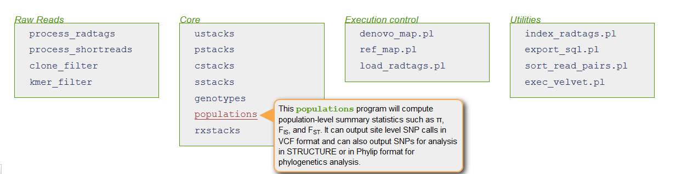
Options for population-level analysis

Slide 18
Haplotypes file
# Catalog ID | Cnt | Seg Dist | sample_AACTTGT | sample_ACACGGT | sample_AGAGCCT | sample_AGCTA | sample_AGGAGTC | sample_AGGTCT | sample_AGTCTAT | sample_AGTTCGA | sample_ATATCGT | sample_ATGTCAA | sample_ATTAGCA | sample_ATTCAGT
1 | 24 | 1 | - | - | - | consensus | - | - | consensus | consensus | consensus | consensus | consensus | consensus
2 | 33 | 1 | - | - | CA/TG | - | - | CA/TG | CA/TG | TG | - | CA/TG | - | -
3 | 14 | 1 | - | - | - | - | - | - | - | - | - | G | - | A/G
4 | 3 | 1 | - | - | - | - | - | - | - | - | - | - | - | -
14 | 6 | 1 | - | - | - | - | - | - | - | - | - | consensus | - | -
17 | 10 | 1 | - | - | - | - | - | - | - | consensus | - | - | - | -
18 | 44 | 1 | CA/CC | CA/GA | CA/CC | CA/CC | CC | - | CC | CA/CC | CA/CC/GA | CA/CC | CA/CC | CA/CC
19 | 16 | 0.001 | AG/GA | GA | - | - | - | - | - | - | - | GA | - | -
20 | 5 | 1 | - | - | - | - | consensus | - | - | - | - | - | - | -
21 | 11 | 1 | - | consensus | - | - | - | - | - | consensus | - | - | consensus | -
22 | 14 | 1 | - | - | - | - | - | consensus | - | - | consensus | - | - | -
23 | 14 | 1 | consensus | - | - | consensus | - | - | - | consensus | - | consensus | - | -
24 | 8 | 1 | - | - | - | - | - | - | - | - | - | - | - | -
28 | 30 | 1 | consensus | - | consensus | - | - | - | consensus | consensus | consensus | consensus | consensus | consensus
29 | 24 | 1 | - | - | - | ATCA/CCTT | - | - | - | ATCA | - | - | CCTT | -
30 | 39 | 0.0005 | CCTT | - | - | ATCA/CCTT | CCTT | CCTT | CCTT | CCTT | ATCA/CCTT | ATCA/CCTT | CCTT | -
33 | 25 | 1 | - | - | - | consensus | - | - | - | consensus | consensus | consensus | - | -
34 | 33 | 1 | consensus | consensus | - | consensus | - | consensus | - | consensus | consensus | consensus | consensus | -
35 | 12 | 1 | consensus | - | - | - | - | - | - | - | - | - | consensus | -
36 | 20 | 1 | consensus | - | consensus | - | - | - | - | - | - | consensus | - | -
37 | 34 | 1 | consensus | consensus | consensus | consensus | consensus | - | - | consensus | - | consensus | consensus | -
38 | 22 | 0.0005 | A/G | - | - | - | G | G | - | G | - | - | G | -
39 | 24 | 1 | consensus | - | - | consensus | - | - | - | consensus | - | consensus | - | consensus
40 | 46 | 0.0005 | G | G | A/G | G | G | G | G | A/G | G | A/G | A/G | -
41 | 11 | 1 | - | - | - | C | - | - | C/G | - | - | - | - | -
42 | 48 | 0.0005 | GC | GC/TT | GC | GC/TT | GC | GC/TT | GC | GC/TT | GC/TT | GC | GC | GC/TT
43 | 6 | 1 | - | - | - | - | - | - | - | consensus | - | - | - | -
45 | 30 | 0.001 | AAA | - | AAA | GCT | - | - | - | - | - | AAA | - | AAA

